Slide 1


Qiskit Hackathon@World of Quantum
Joshua Ammermann, Domenik Eichhorn, Rinor Kelmendi, Piotr Malkowski, Nick Poser

Slide 2
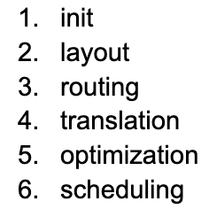
Qiskit Transpiler Pipeline
Notes:
As computer scientists, we tried to find a topic that utilized our strengts and reduced the deep quantum knowledge, that for instance physics have
At first we thought of looking into optimization of connectivity graphs through optimization methods. This is part of layout and routing transpiler stage
We then brainstormed which stage could be easiest to play with - meaning which Pass Manager has most passes to play with, with least mandatory dependencies to allow us to experiment easily.
The answer was the optimization layer. Seeing that IBM has already implemented reinforcement learning for a few of the passes in this stage, we thought we could move one abstraction layer up, and create machine learning model which learns the best passes configurations for each of the circuits instead of relying on hardcoded preset configurations which qiskit offers.
At the same time, not sure if our approach will yield results, we have split our time into two groups, one with Joshua and Rinor and the second one consisting of Domenik, Nick and me.

Slide 3
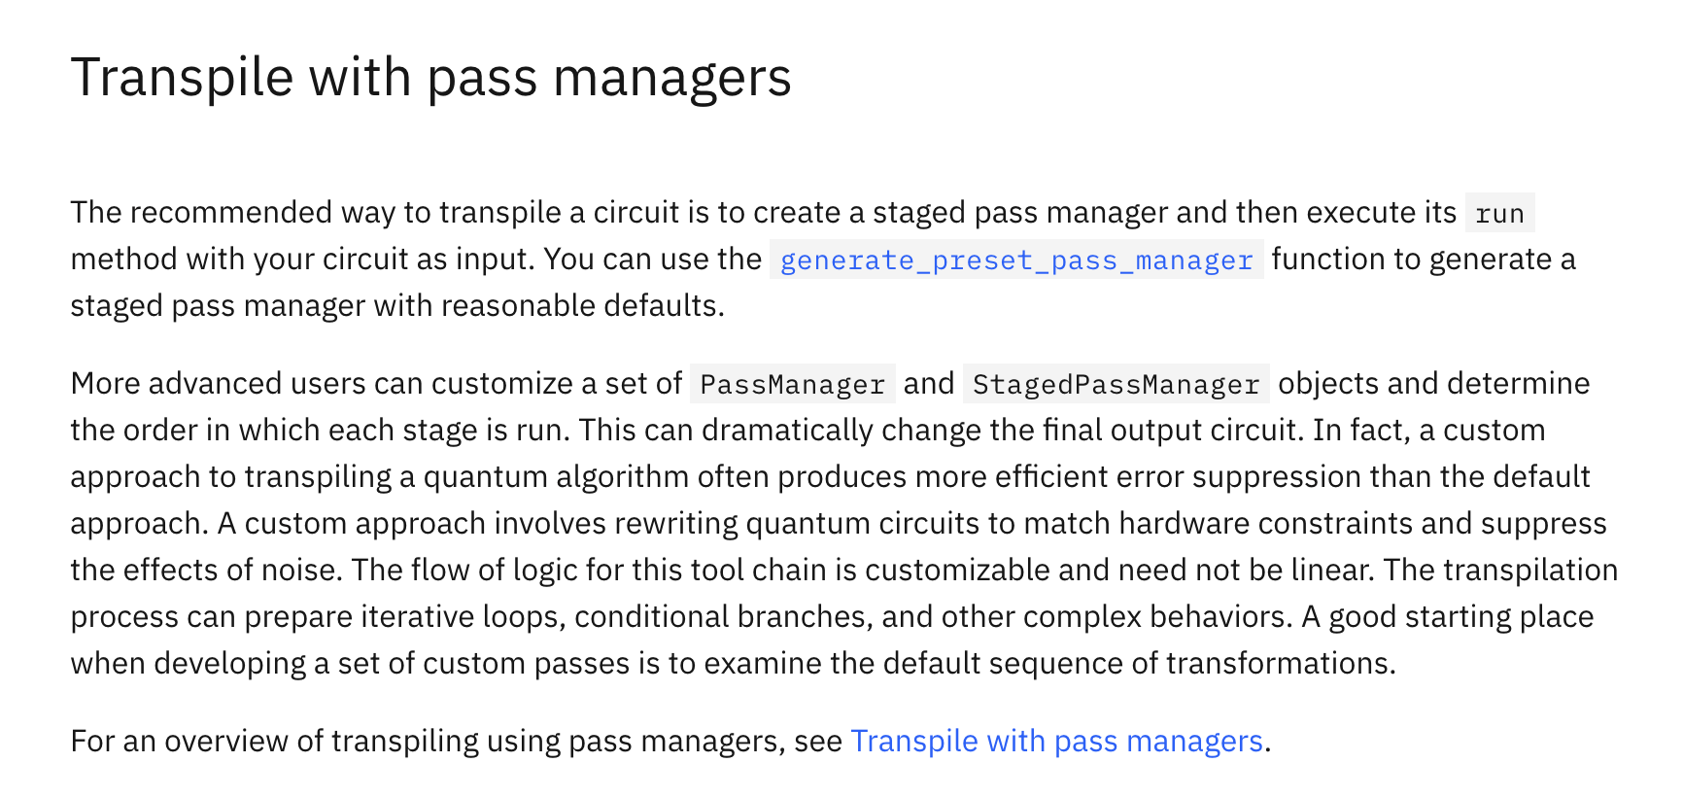

Qiskit Transpiler Pipeline
Qiskit Website
Notes:
As computer scientists, we tried to find a topic that utilized our strengts and reduced the deep quantum knowledge, that for instance physics have
At first we thought of looking into optimization of connectivity graphs through optimization methods. This is part of layout and routing transpiler stage
We then brainstormed which stage could be easiest to play with - meaning which Pass Manager has most passes to play with, with least mandatory dependencies to allow us to experiment easily.
The answer was the optimization layer. Seeing that IBM has already implemented reinforcement learning for a few of the passes in this stage, we thought we could move one abstraction layer up, and create machine learning model which learns the best passes configurations for each of the circuits instead of relying on hardcoded preset configurations which qiskit offers.
At the same time, not sure if our approach will yield results, we have split our time into two groups, one with Joshua and Rinor and the second one consisting of Domenik, Nick and me.

Slide 4
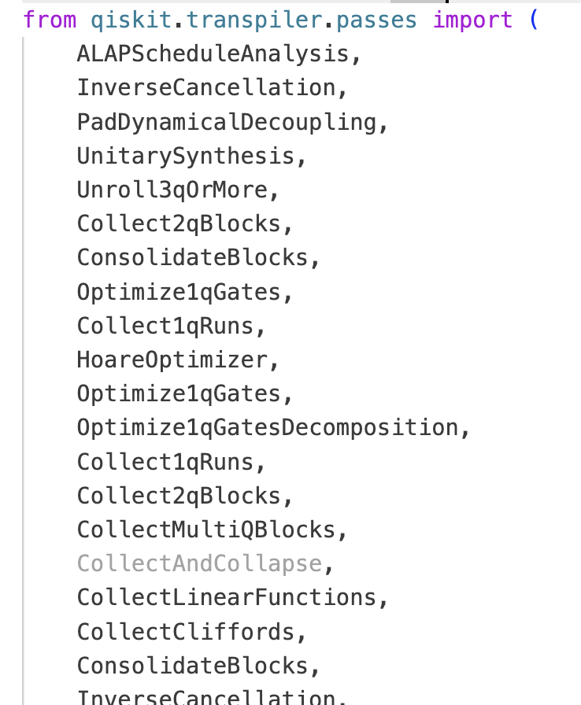
Qiskit Transpiler Pipeline
total of 27 different passes → MANY possible combinations → Using all is not reasonable (especially for large circuits)
Our Idea: Predict Optimal Combinations with Machine Learning
Notes:
As computer scientists, we tried to find a topic that utilized our strengts and reduced the deep quantum knowledge, that for instance physics have
At first we thought of looking into optimization of connectivity graphs through optimization methods. This is part of layout and routing transpiler stage
We then brainstormed which stage could be easiest to play with - meaning which Pass Manager has most passes to play with, with least mandatory dependencies to allow us to experiment easily.
The answer was the optimization layer. Seeing that IBM has already implemented reinforcement learning for a few of the passes in this stage, we thought we could move one abstraction layer up, and create machine learning model which learns the best passes configurations for each of the circuits instead of relying on hardcoded preset configurations which qiskit offers.
At the same time, not sure if our approach will yield results, we have split our time into two groups, one with Joshua and Rinor and the second one consisting of Domenik, Nick and me.

Slide 5
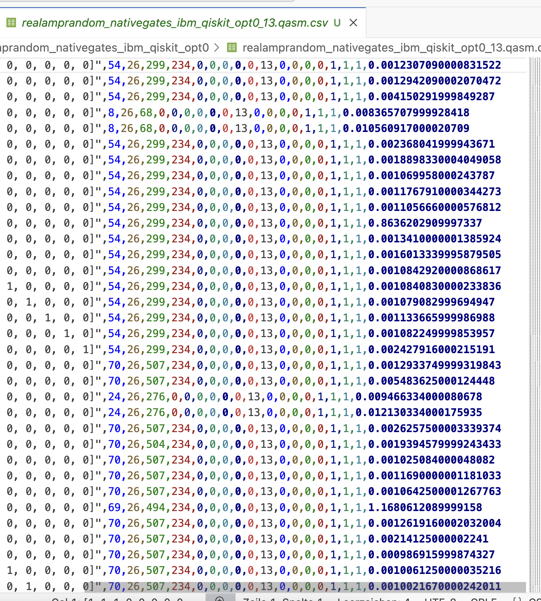
Applying Machine Learning
Output Step 1:
(around 250 of such files)
Step 1: Gather Data
Aim: Execute Compiler Passes on MQT-Bench Benchmarking Set & measure how they effect the circuits.
→ Takes a lot of time… solution: (1) Drop all circuits with > 25 qubits
(2) Do not test all possible combinations of compiler passes, only test pairs of 3 (still a total of ~1000 passes / circuit)

Slide 6
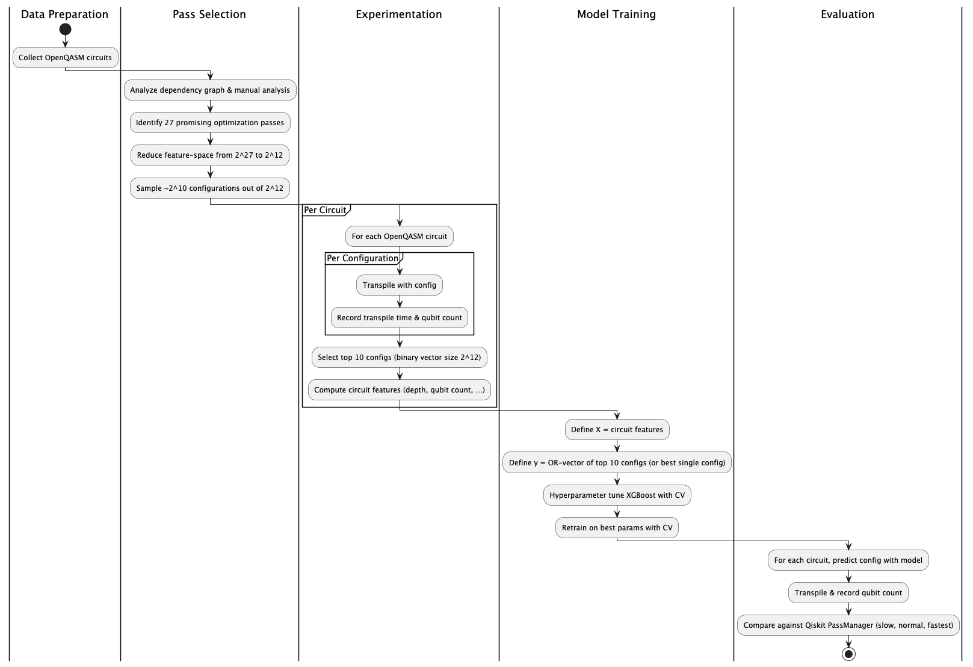
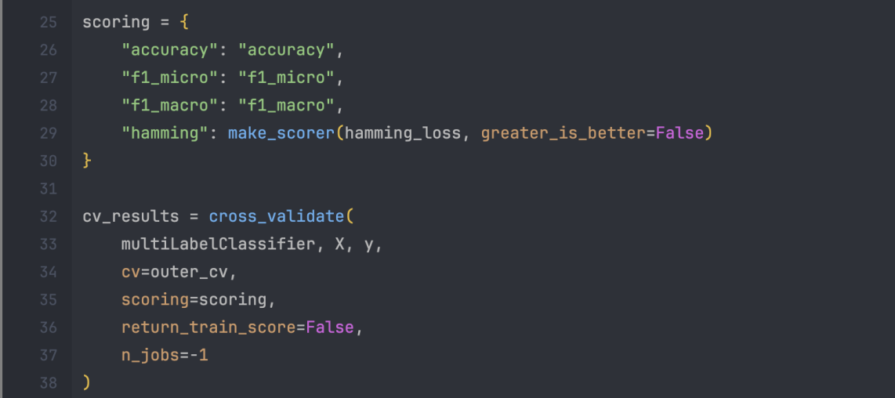
Applying Machine Learning
Step 2: Train Model
Uses multi-label classificator supervised Learning.
Implementations Details are too much for this short presentation, we tried to explain it in the Jupyter Notebook ☺

Slide 7
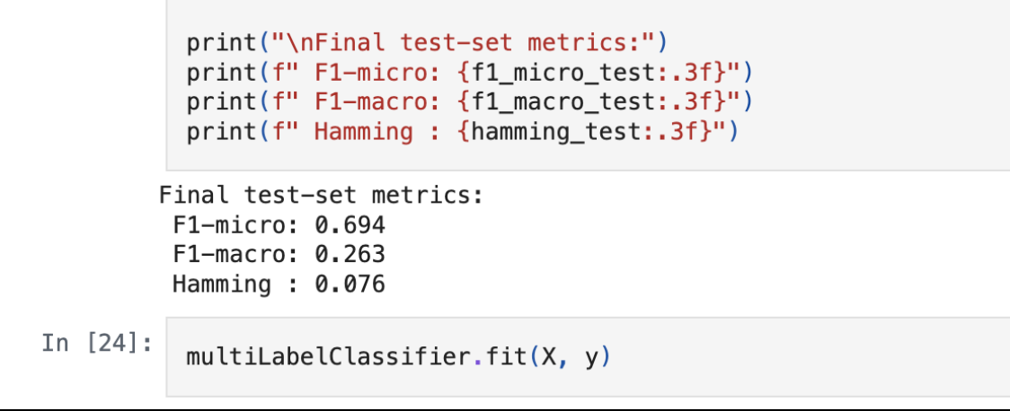
Results – ML based Transpilation Approach
Sadly, not enough time for intensive training & evaluation
On average, Prototype is ~30% away from the optimal pass configuration
(Expected to improve with more training, data, & thinking)

Slide 8
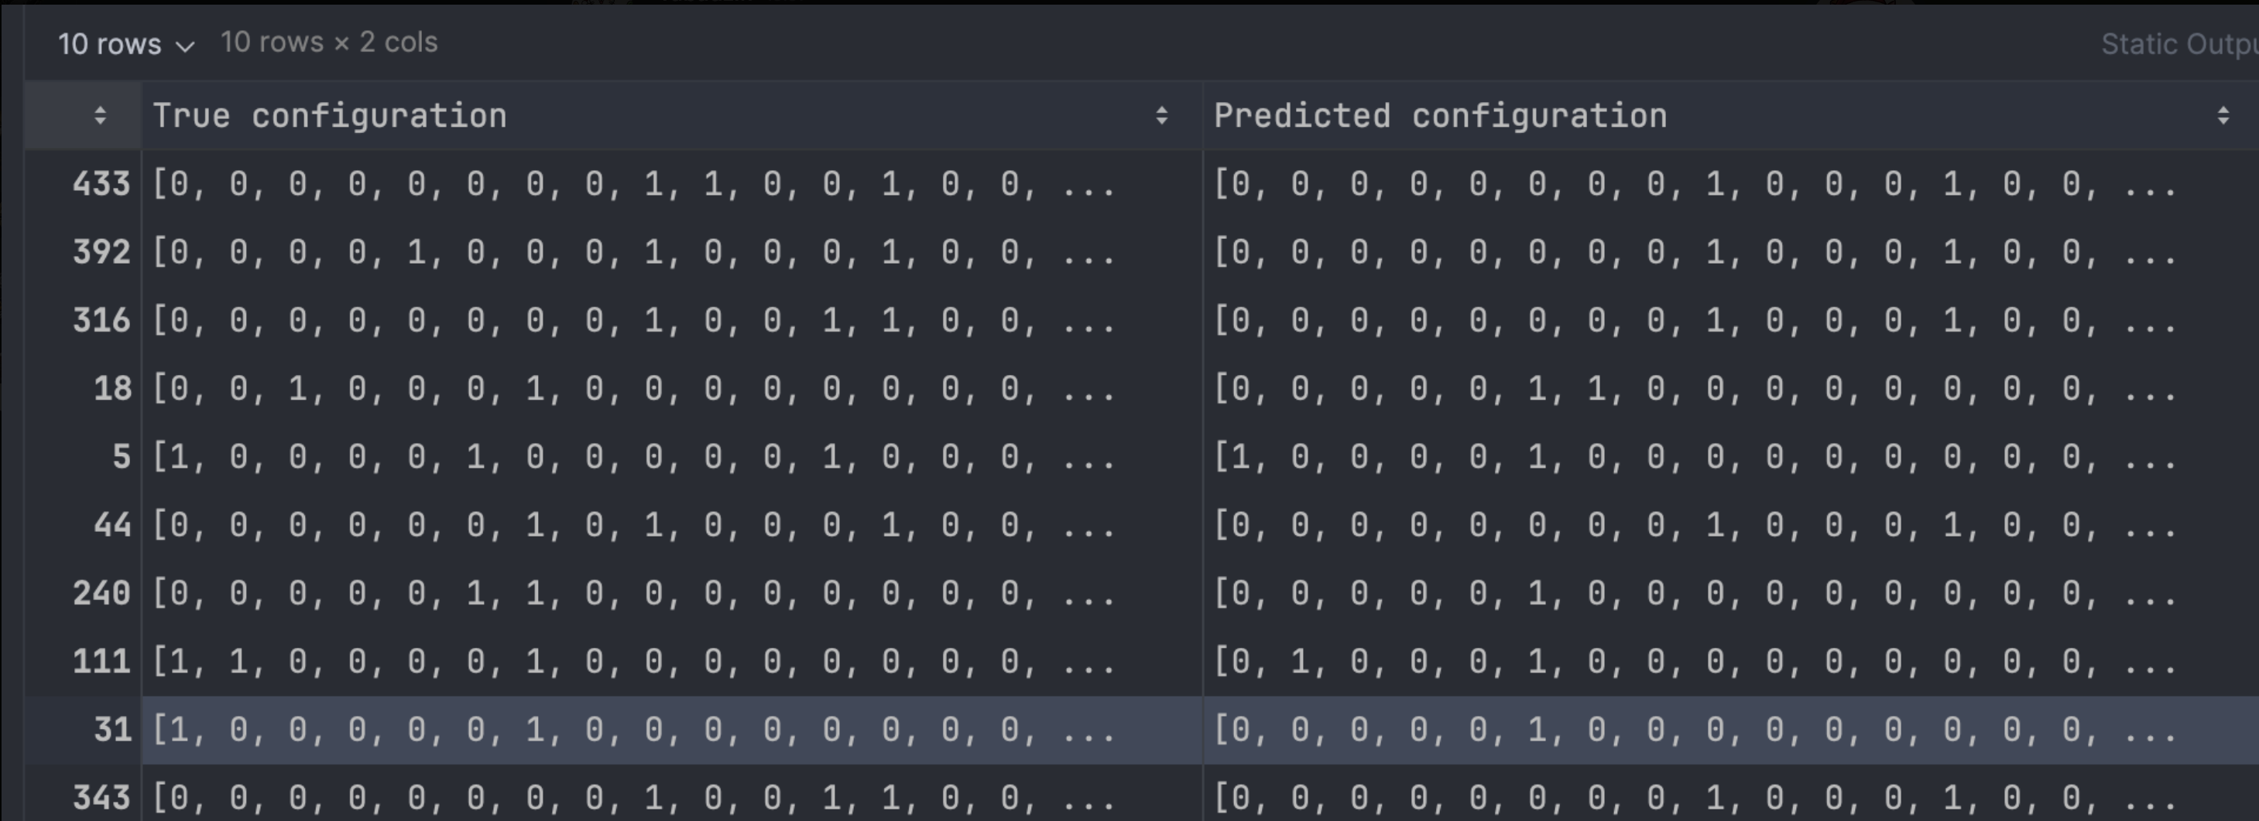
Results – ML based Transpilation Approach

Slide 9
Main Takeways (We learned a lot ☺ )
When evaluating compiler passes, you have to be really careful with the benchmarking set that you select. → The first examples that we used were already really optimized, so the compiler passes were barely able to change anything.
The Qiskit Default compiler pipeline is already really good. → We had to actively deactive many features to measure the see the impact of optimization passes.

Slide 10
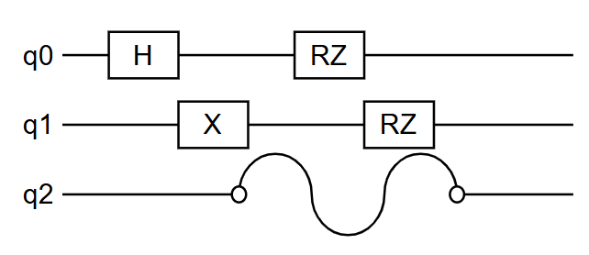
Optimization 2: Error Supression
Problem: Idle qubits tend to disturb nearby qubits. (Decoherence)

Slide 11
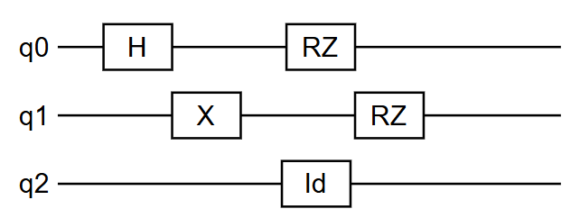
Dynamical Decoupling
Solution: Dynamical Decoupling
Use identity gates to keep idle qubits busy.

Slide 12
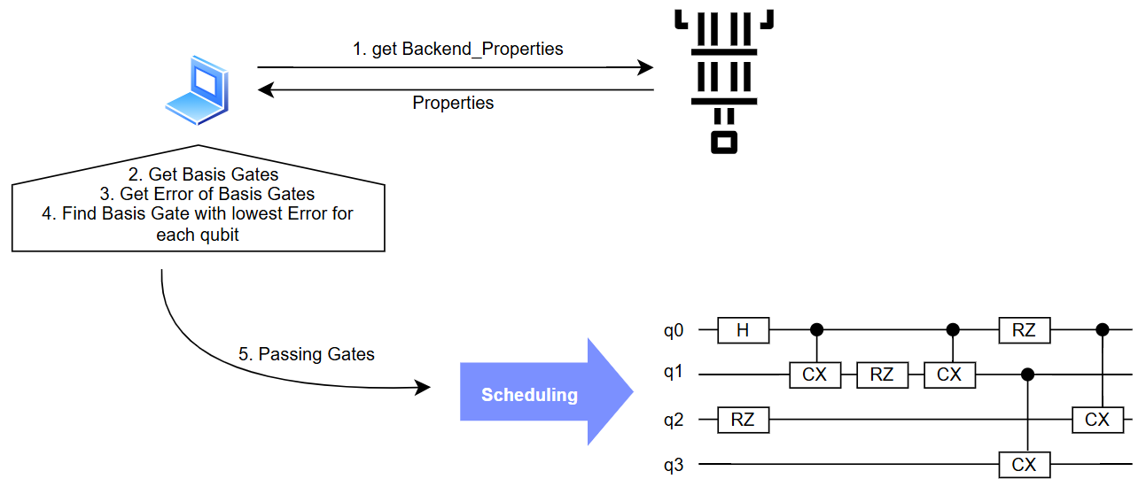
Dynamical Decoupling Optimization
Optimization: Create identity gates with lowest error basis gate for each qubit.

Slide 13
Dynamical Decoupling Optimization
Optimization: Create identity gates with lowest error basis gate for each qubit.

Slide 14
Dynamical Decoupling Optimization
Optimization: Create identity gates with lowest error basis gate for each qubit.

Slide 15
Dynamical Decoupling Optimization
Optimization: Create identity gates with lowest error basis gate for each qubit.

Slide 16
Dynamical Decoupling Optimization
Optimization: Create identity gates with lowest error basis gate for each qubit.

Slide 17
Dynamical Decoupling Optimization
Optimization: Create identity gates with lowest error basis gate for each qubit.

Slide 18
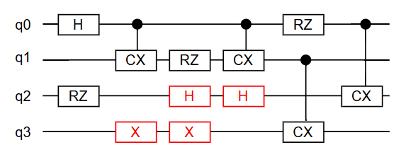
Dynamical Decoupling Optimization
Optimization: Create identity gates with lowest error basis gate for each qubit.

Slide 19
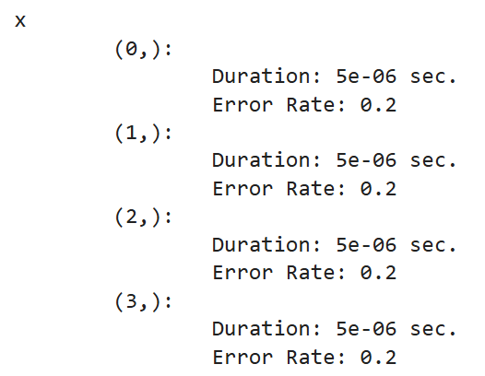
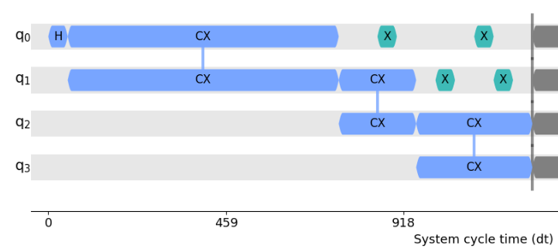
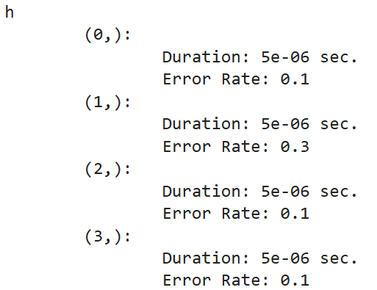
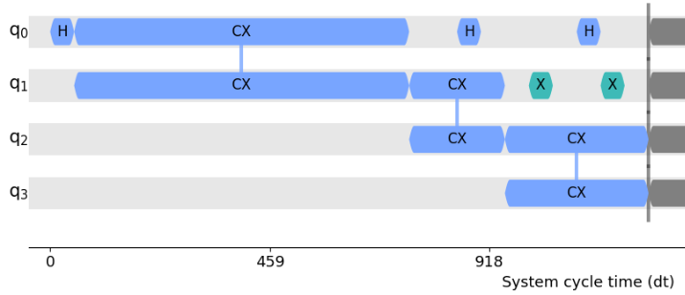
Dynamical Decoupling Implementation

